Slide 1

Hanwash Performance Indicator (H.P.I)
This user guide will help you navigate to this console. And display the features available.

Slide 2
H.P.I console
How to access the console?

Slide 3
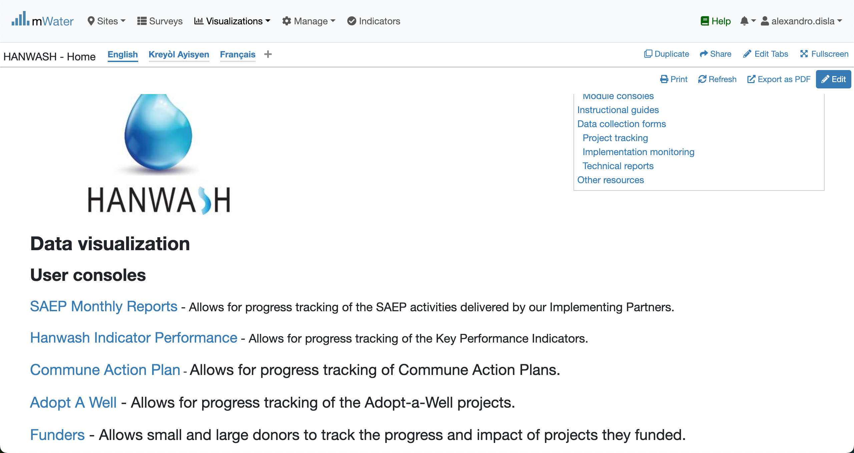
Hanwash HOME
URL LINK : http://go.mwater.co/hanwash

Slide 4
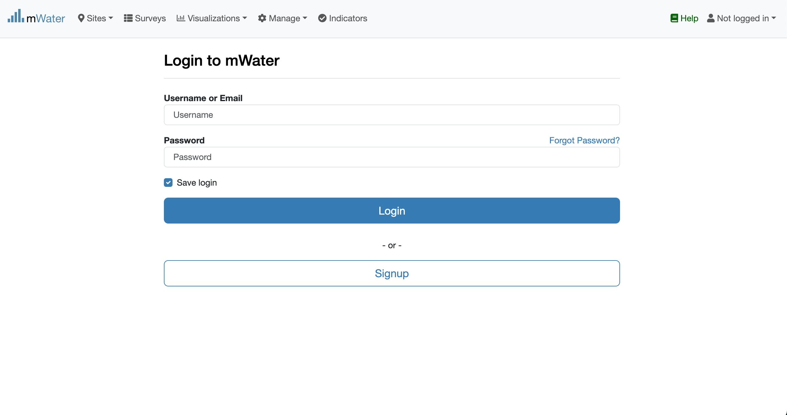
Access The H.P.I Console & Login process
Click on the H.P.I console url link
Please enter your Credentials (username ,console)
Log status indicator

Slide 5

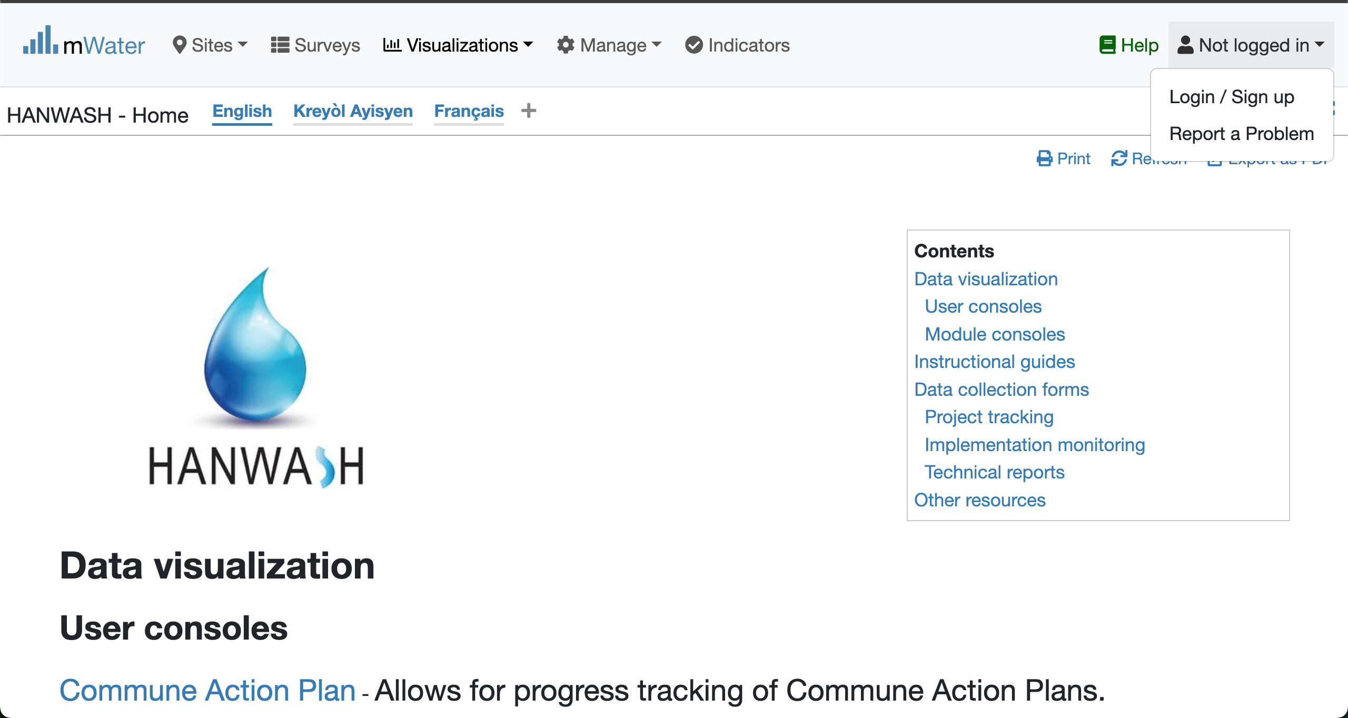


Login Process (2nd scenario)
Click to Login or Signup
Please Click on this selection box
Please enter your Credentials

Slide 6
Console Overview
1. The Introduction (Static)
2. The HANWASH Indicators

Slide 7
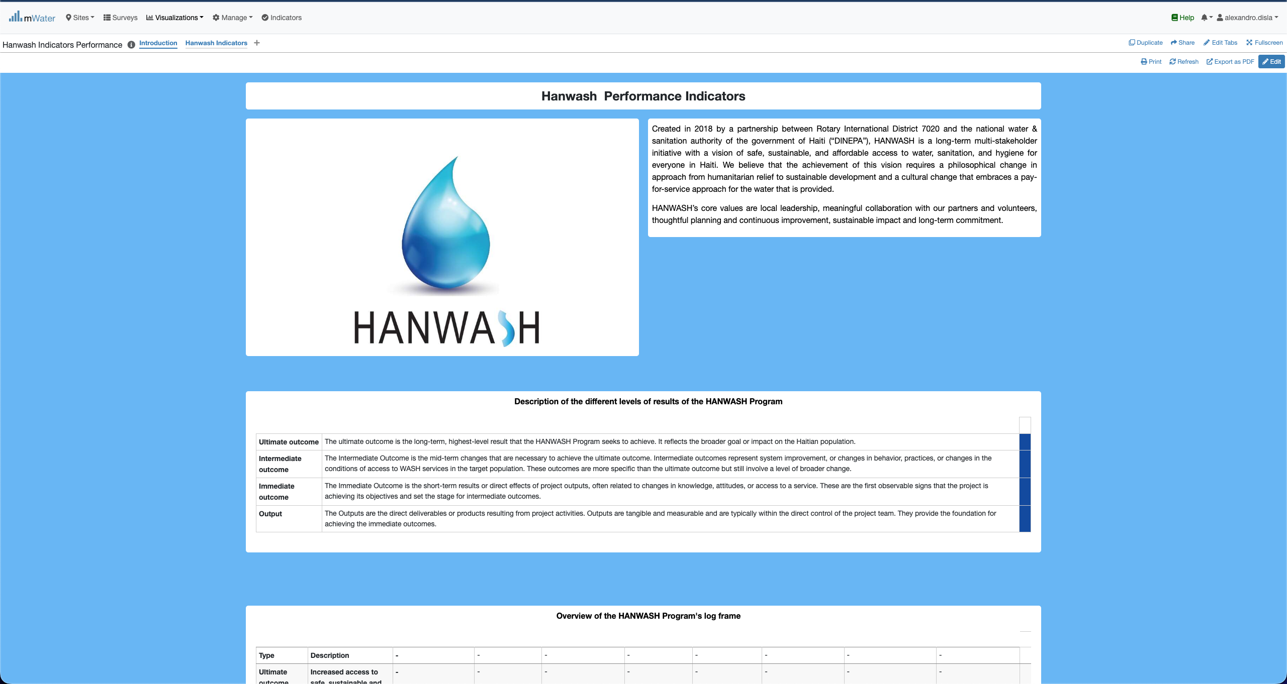
H.P.I Console overview

Slide 8
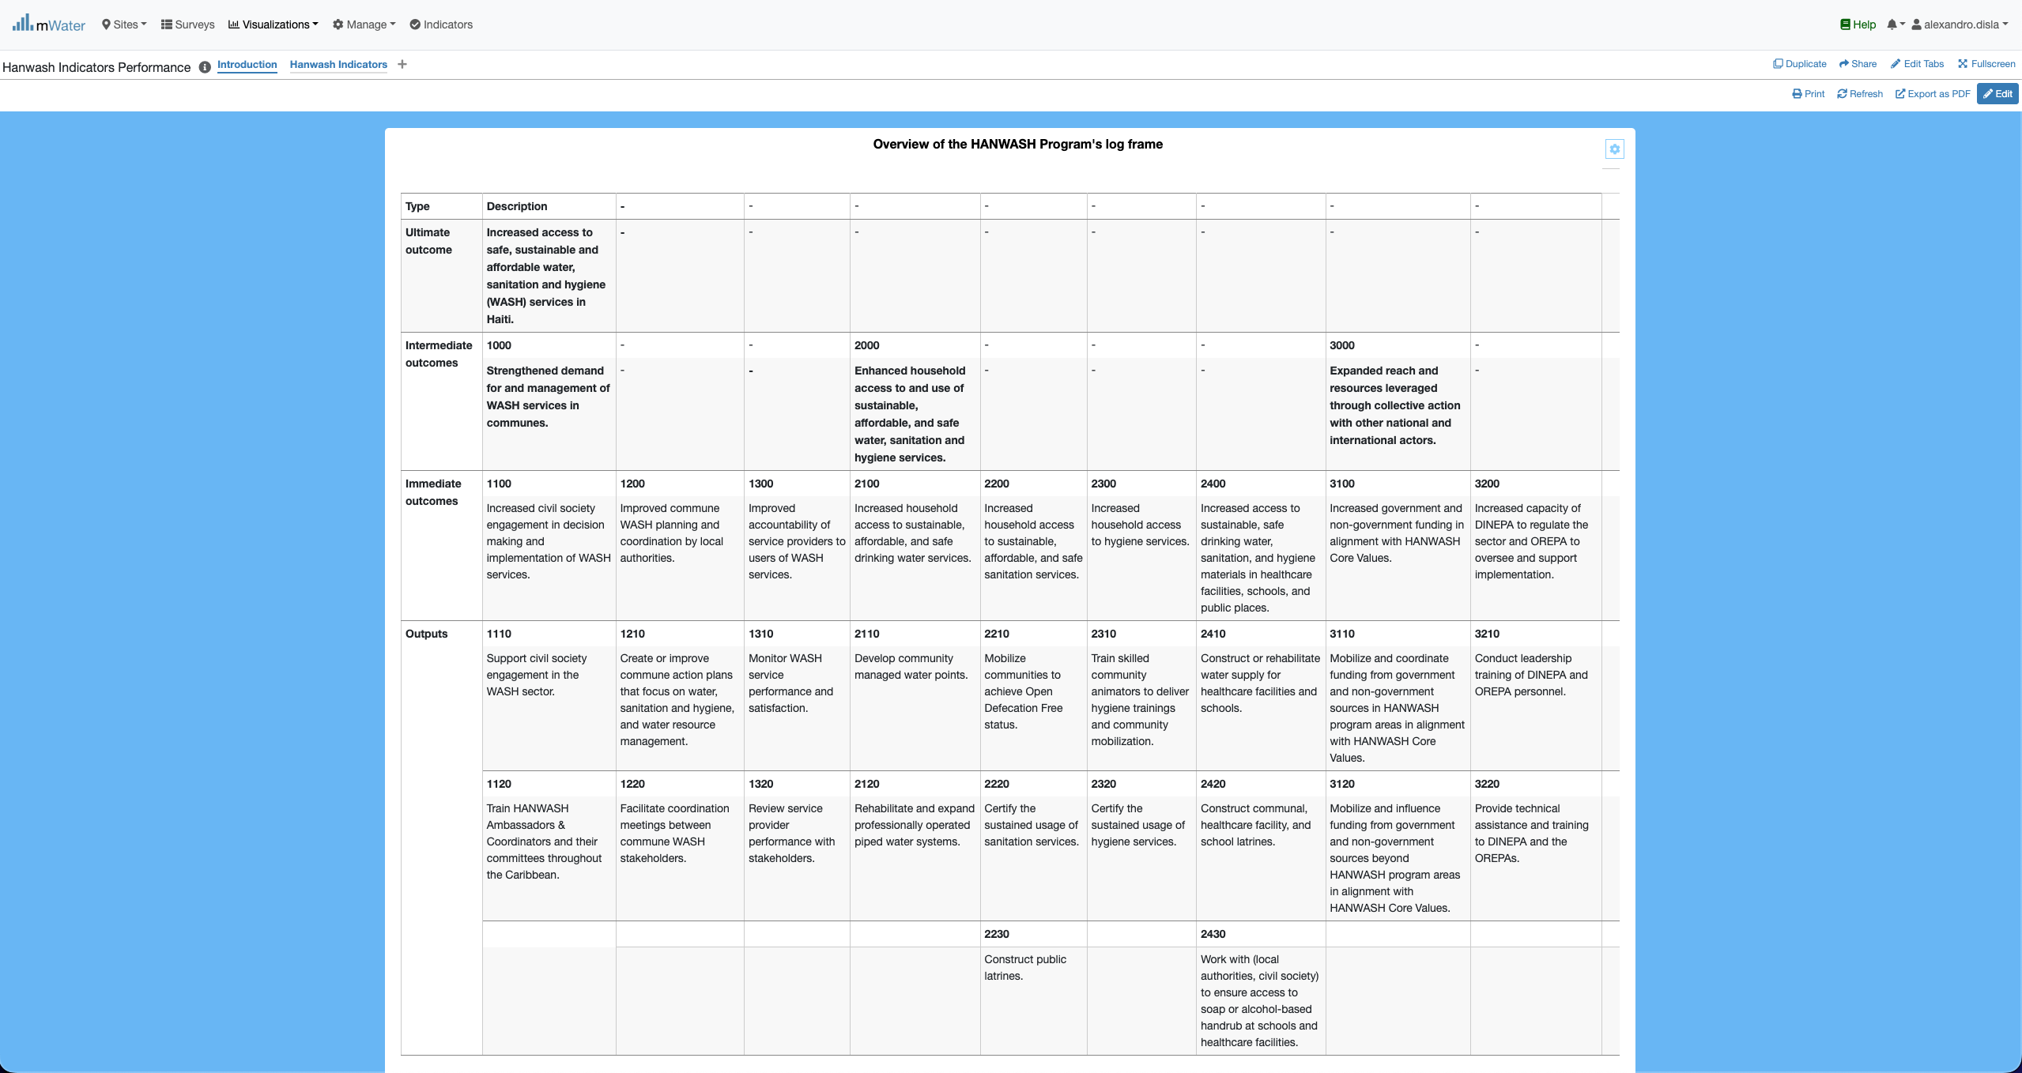
H.P.I Console overview

Slide 9
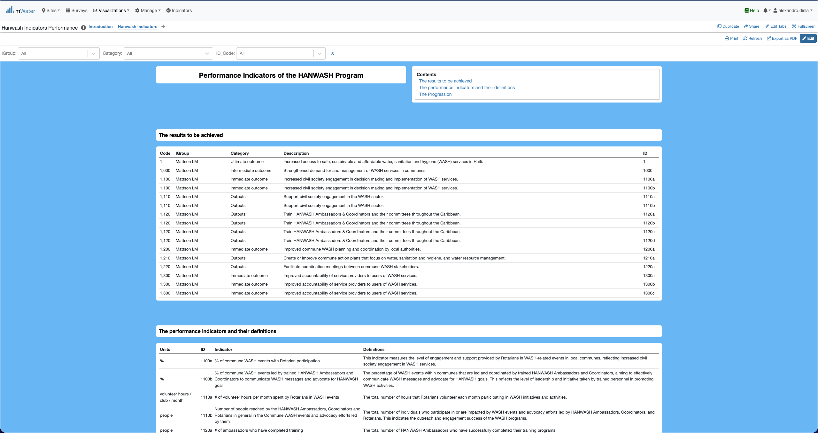
H.P.I Console overview

Slide 10
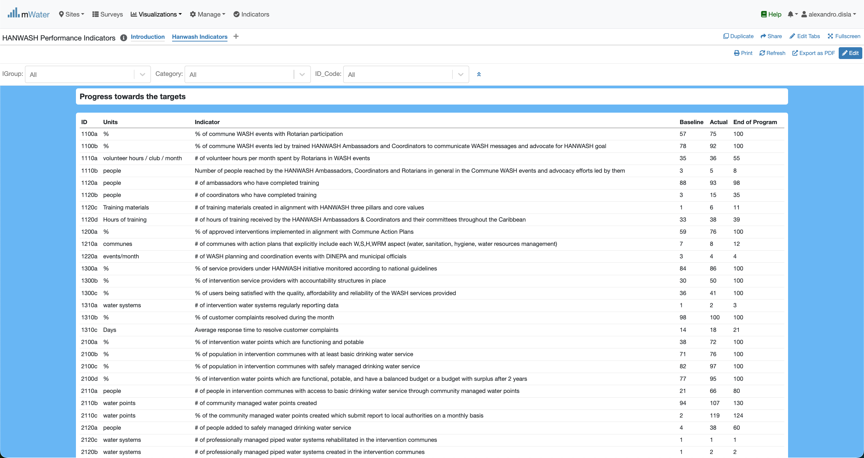
H.P.I Console overview

Slide 11
Functionalities
What are the functionalities available?

Slide 12
The introduction page
Introduction:
About Hanwash
Description of the results levels
The HANWASH PROGRAM LOG FRAME

Slide 13
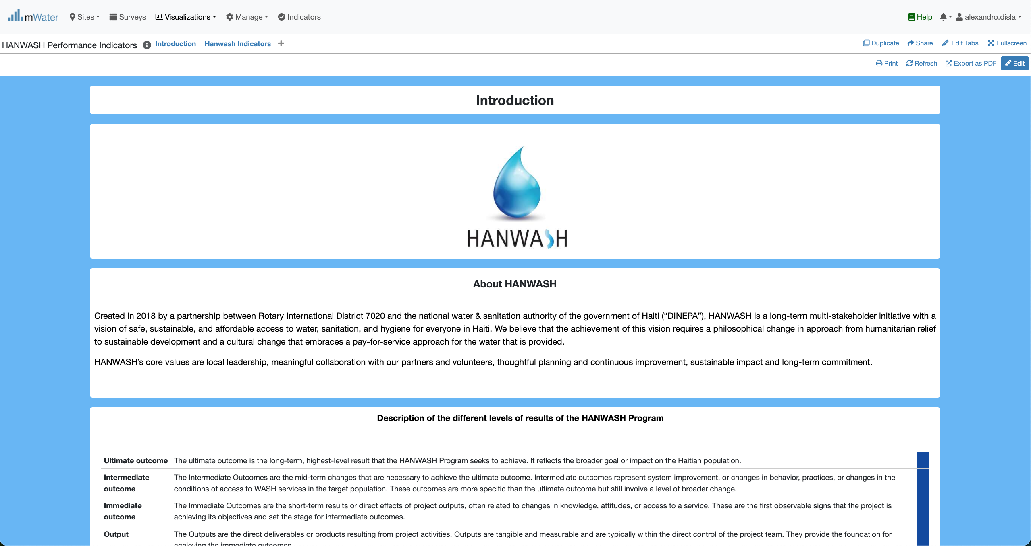
Introduction

Slide 14
Introduction
The key feature of merge and center is missing from the platform. We have place these yellow box to showcase this.

Slide 15
The Main page
Hanwash Indicators:
THE RESULTS TO BE ACHIEVED
THE PERFORMANCE INDICATORS AND THEIR DEFINITIONS
PROGRESS TOWARDS THE INDICATORS

Slide 16
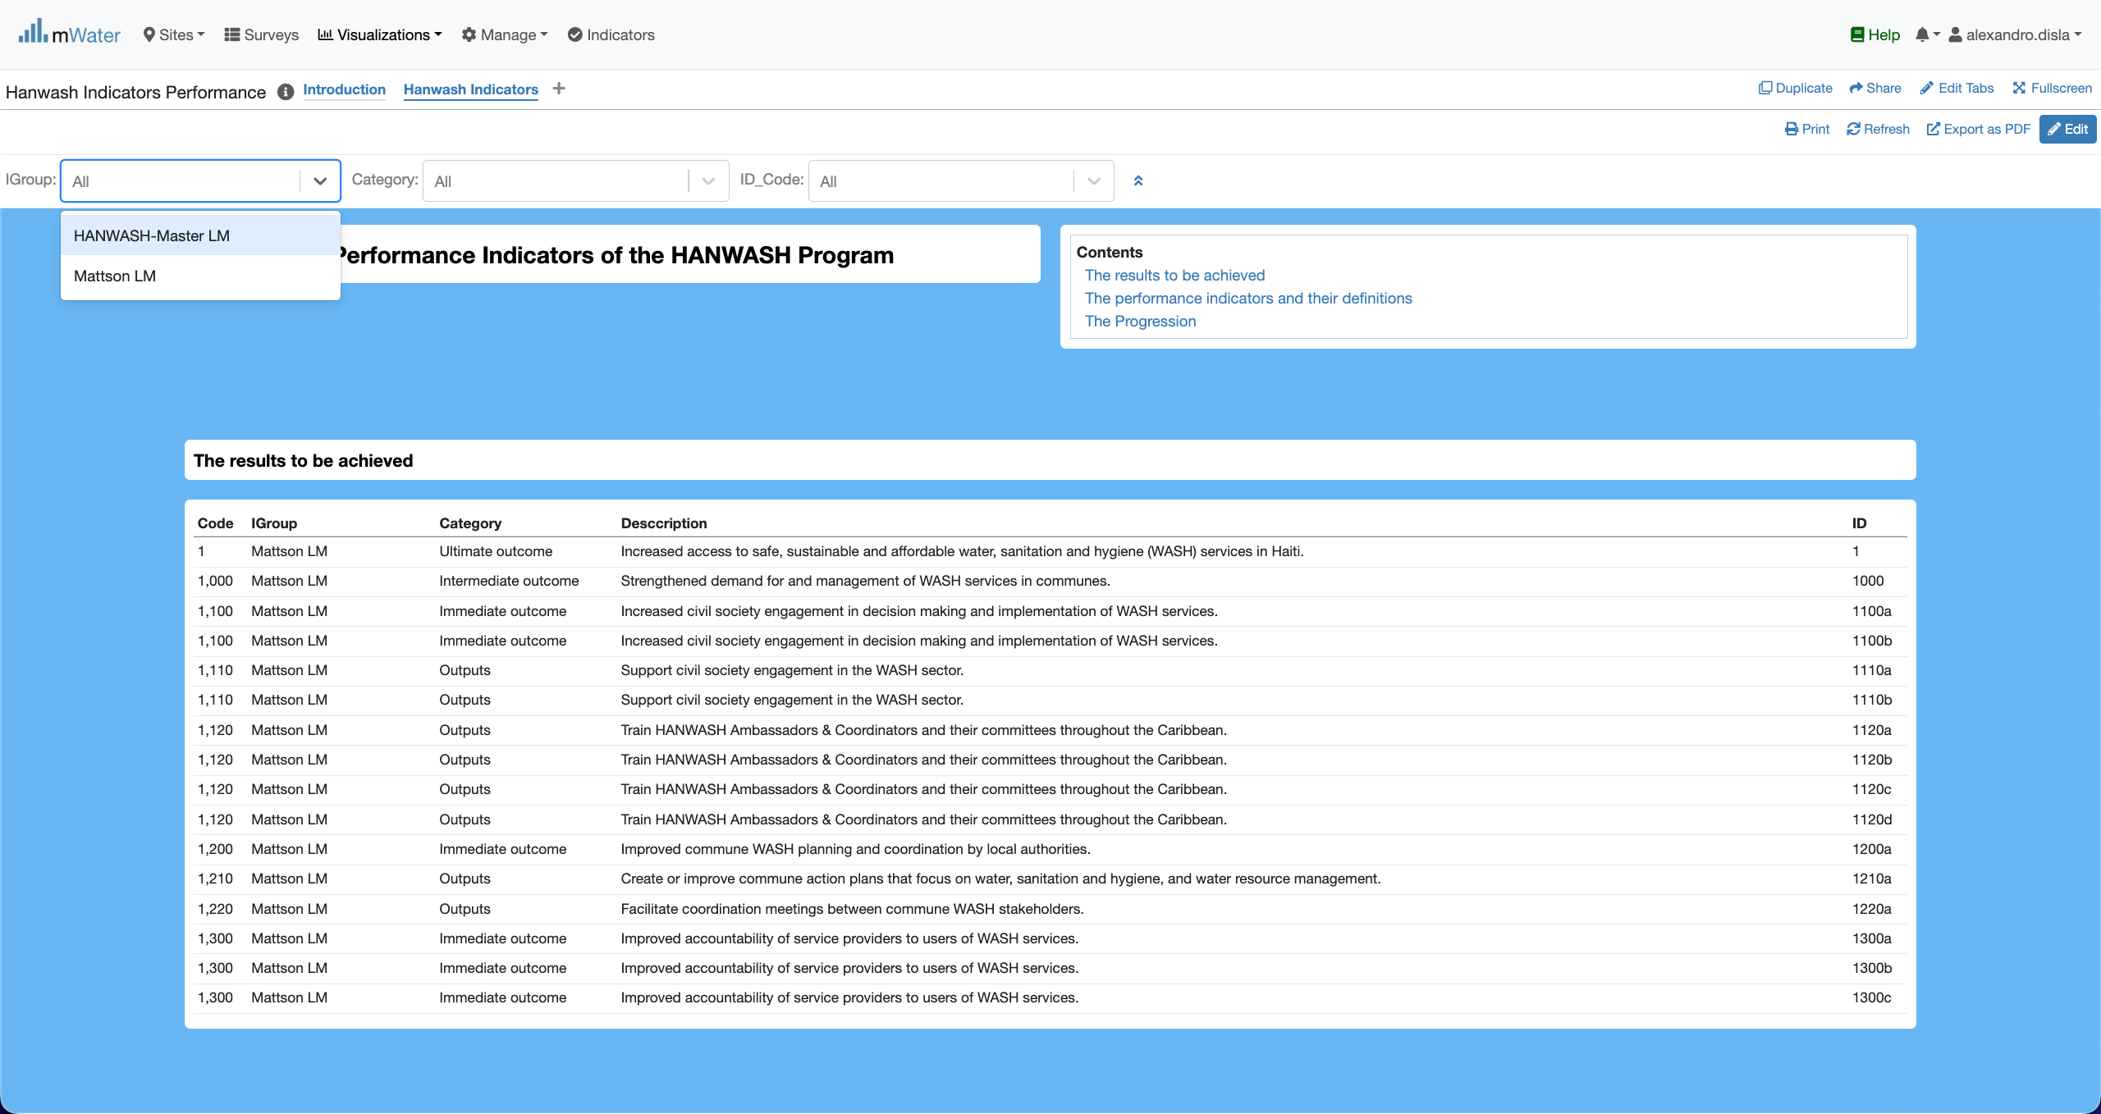
Display the quickfilters
The first filter indicate whether or not the indicator is associated with Mattson Program.

Slide 17
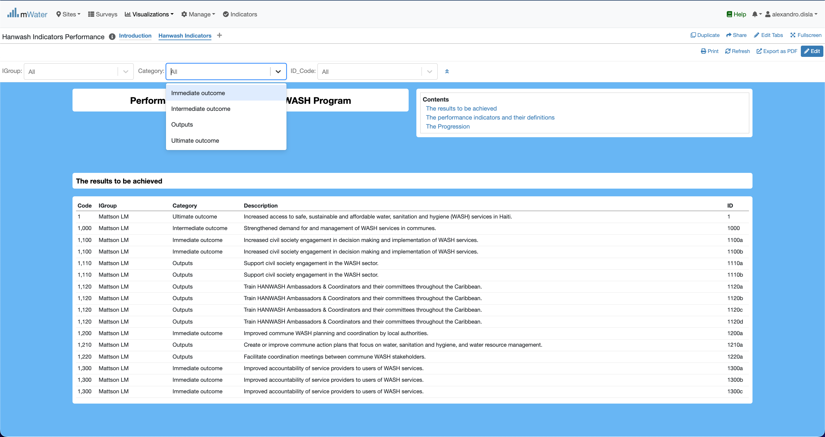
Display the quickfilters
The second filter describe the classification of the indicators by level of results.

Slide 18
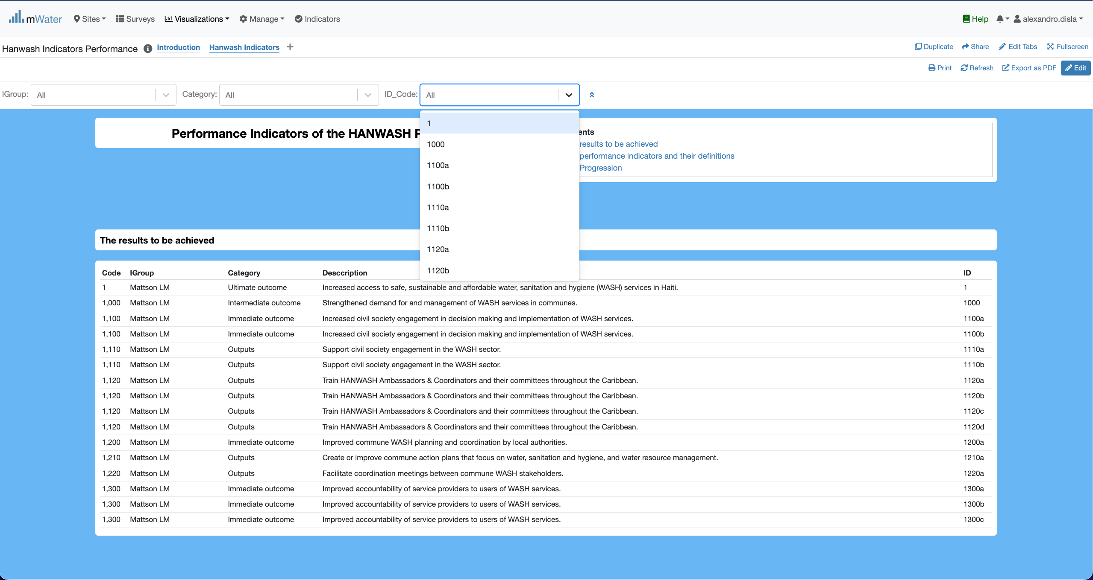
Display the quickfilters
The 3rd filter is the unique ID of the indicator.

Slide 19
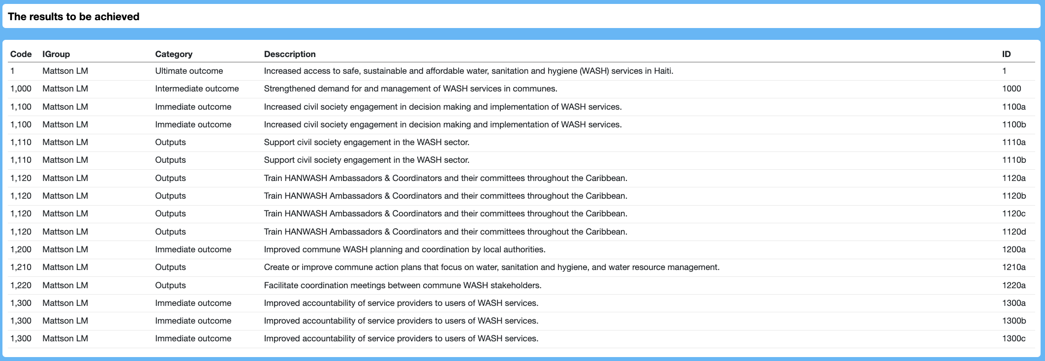
The Results table
Igroup, Category indicated the log frame which the results and indicators were defined
For each category of results, we have a proper definition
The ID is the unique identifier for each results and their corresponding indicator

Slide 20
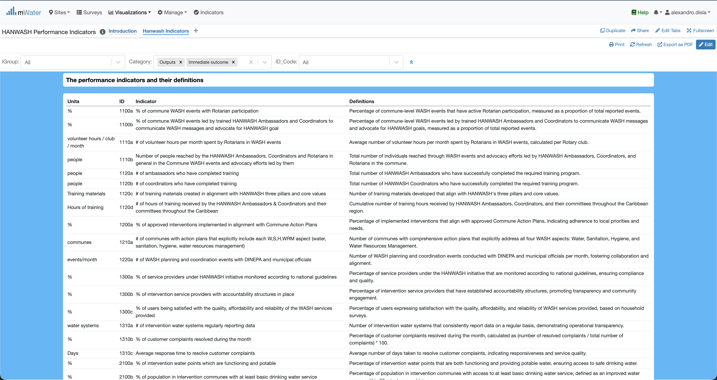
The indicator table
The units column to specify the unit of the indicator. The ID is under the complete control of the ID_code quick filter.
The indicators and their definition

Slide 21
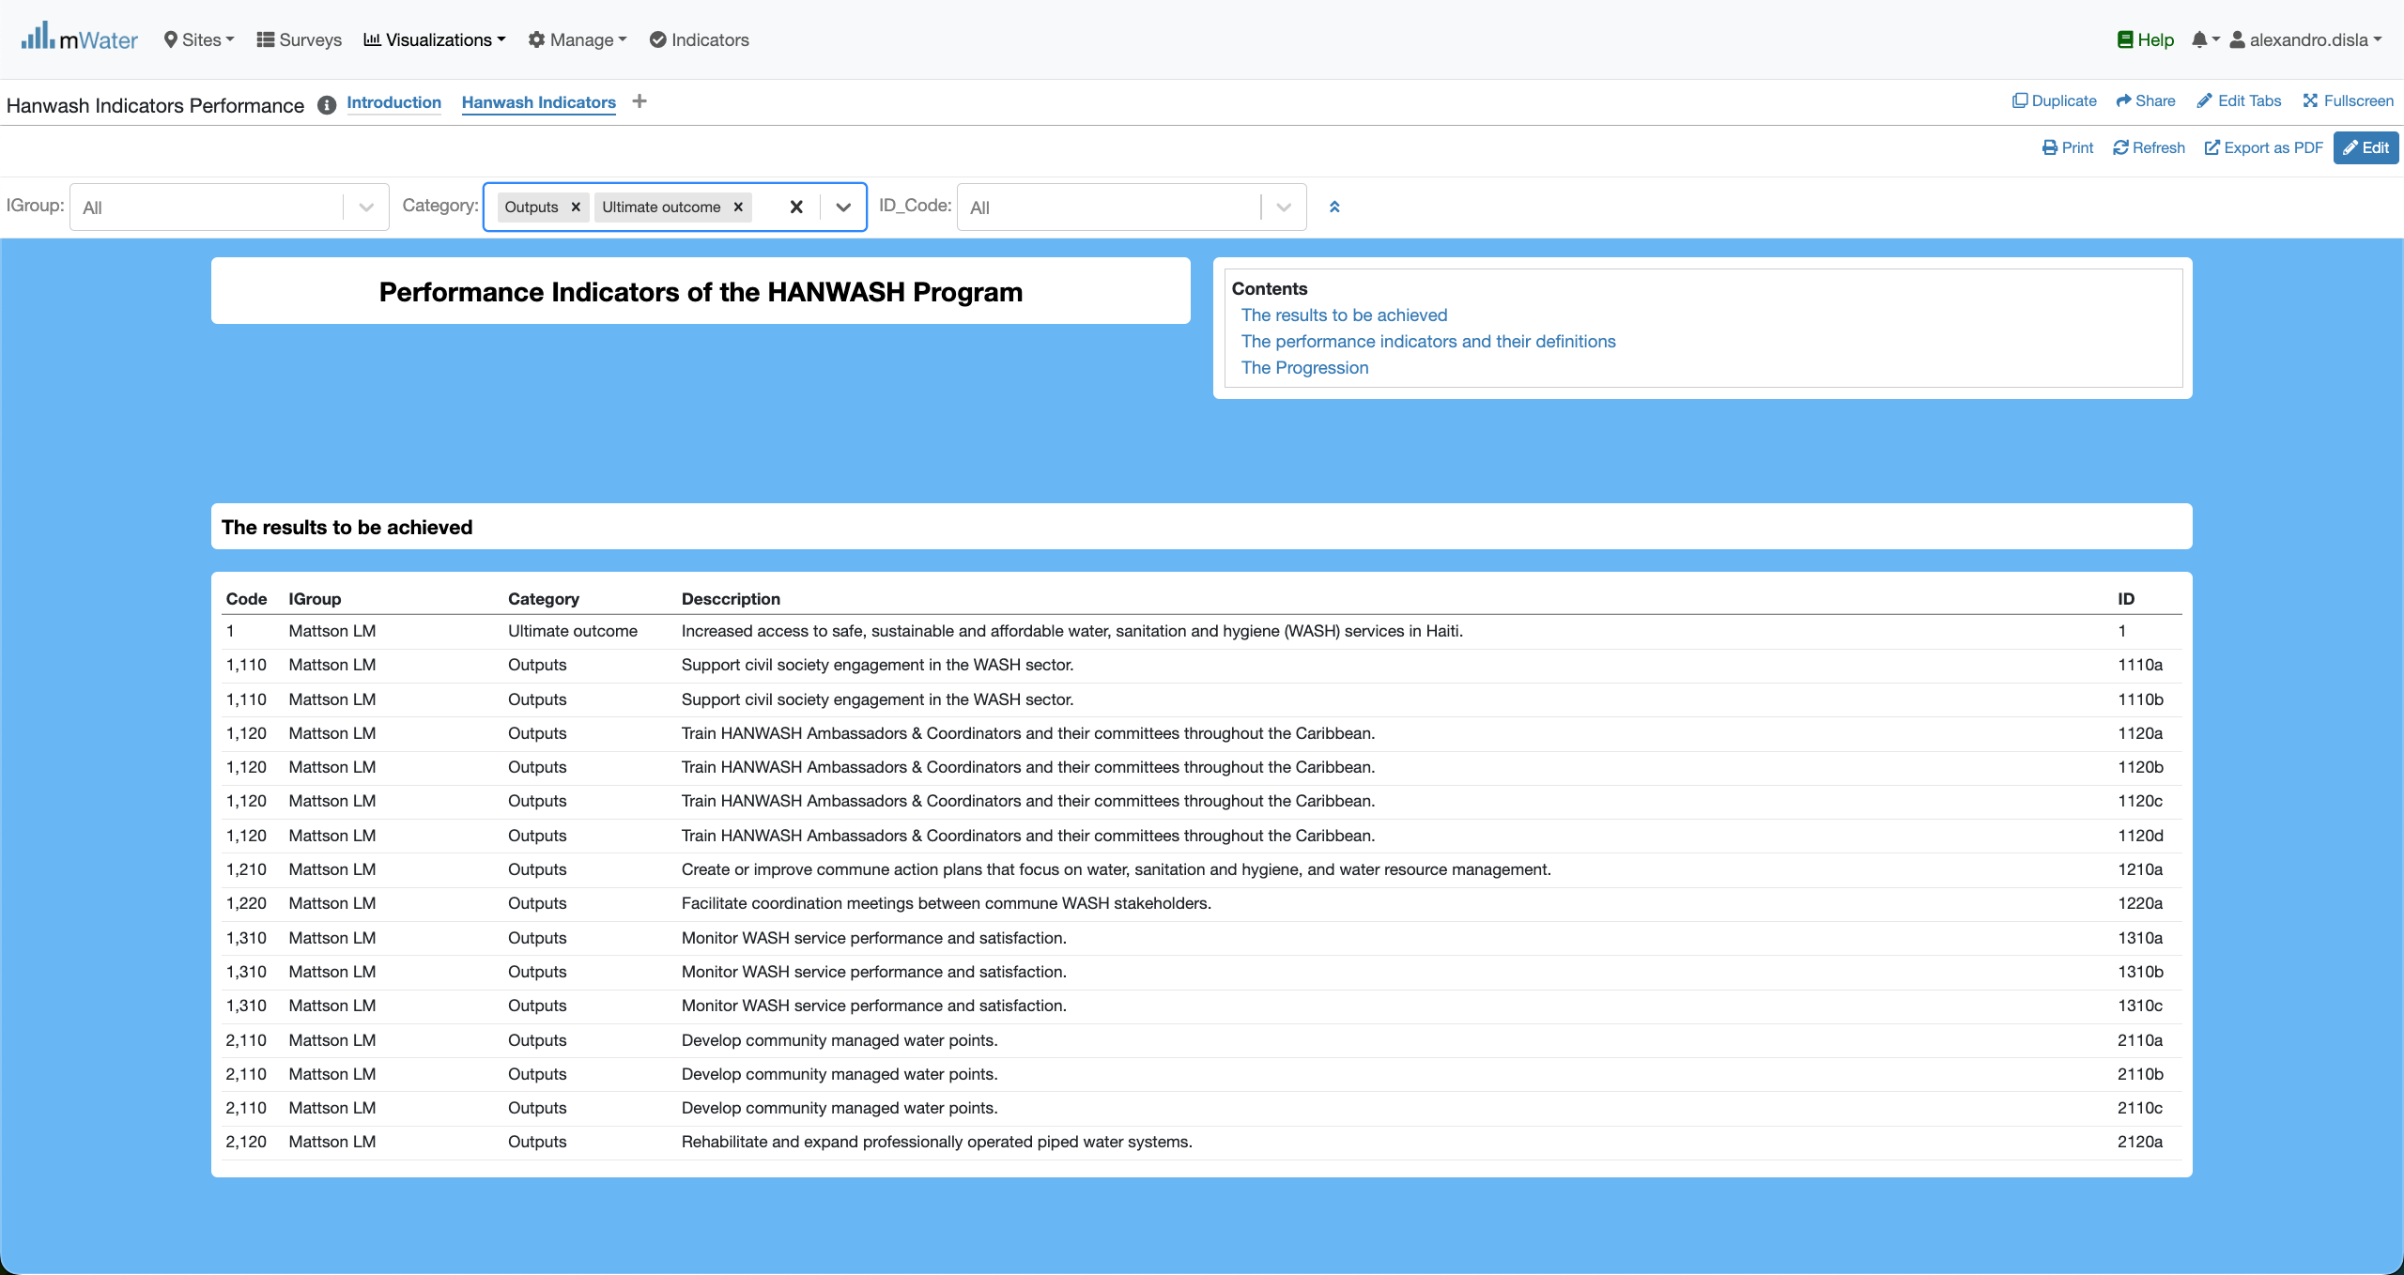
Category quickfilter effect
By design the category quick filter will allow you to select different categories and the section will behave to display the objectives, the definitions and the progression tables.

Slide 22
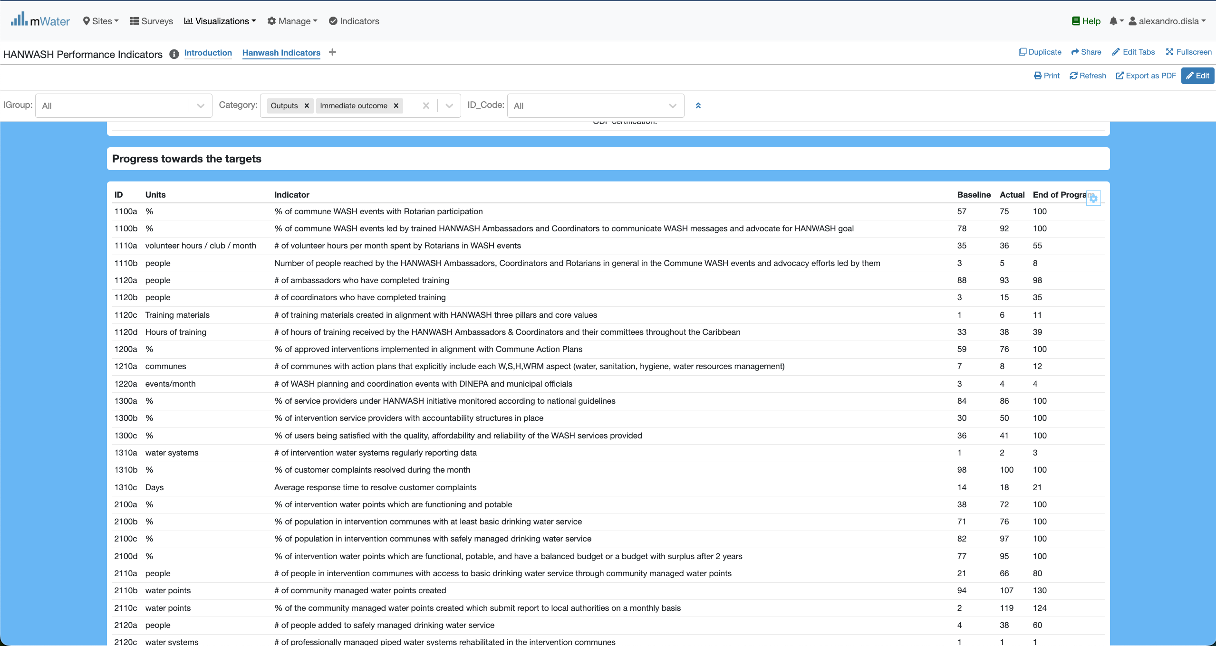
Category quickfilter effect
We have the baseline, Actual. And End of Program value. These Numbers, for now, are generated randomly.
The Indicator table are show based on the category selected.

Slide 23
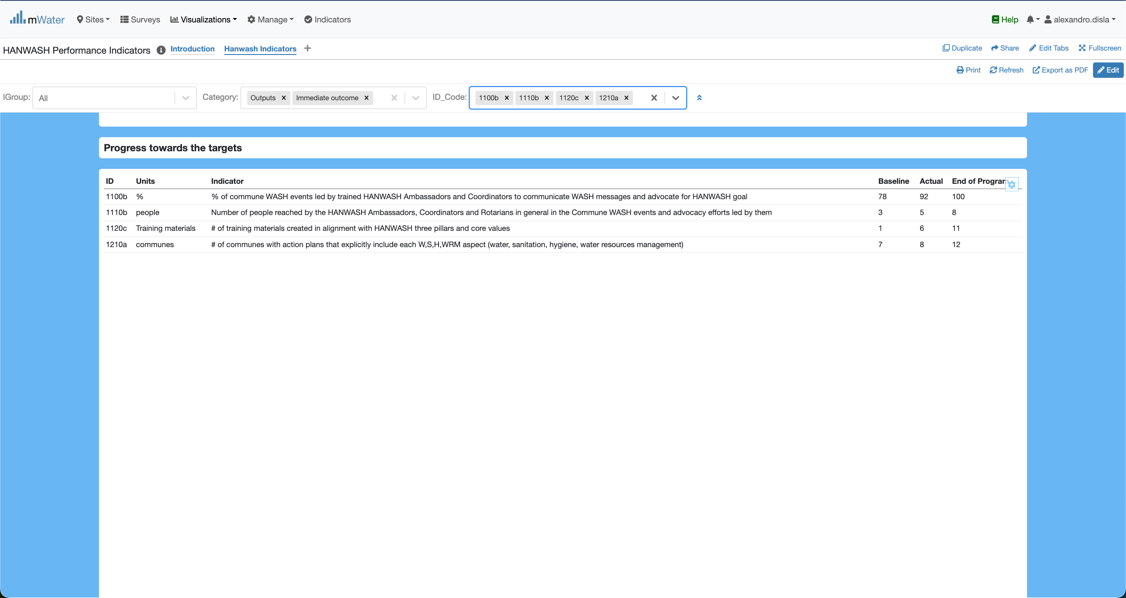
ID_Code quickfilter effect
Both designed to handle multiple choices. The table will reajust based on these choices.
Very practical if you just want to display a set of indicators.

Slide 24
Export
Export table as you need

Slide 25
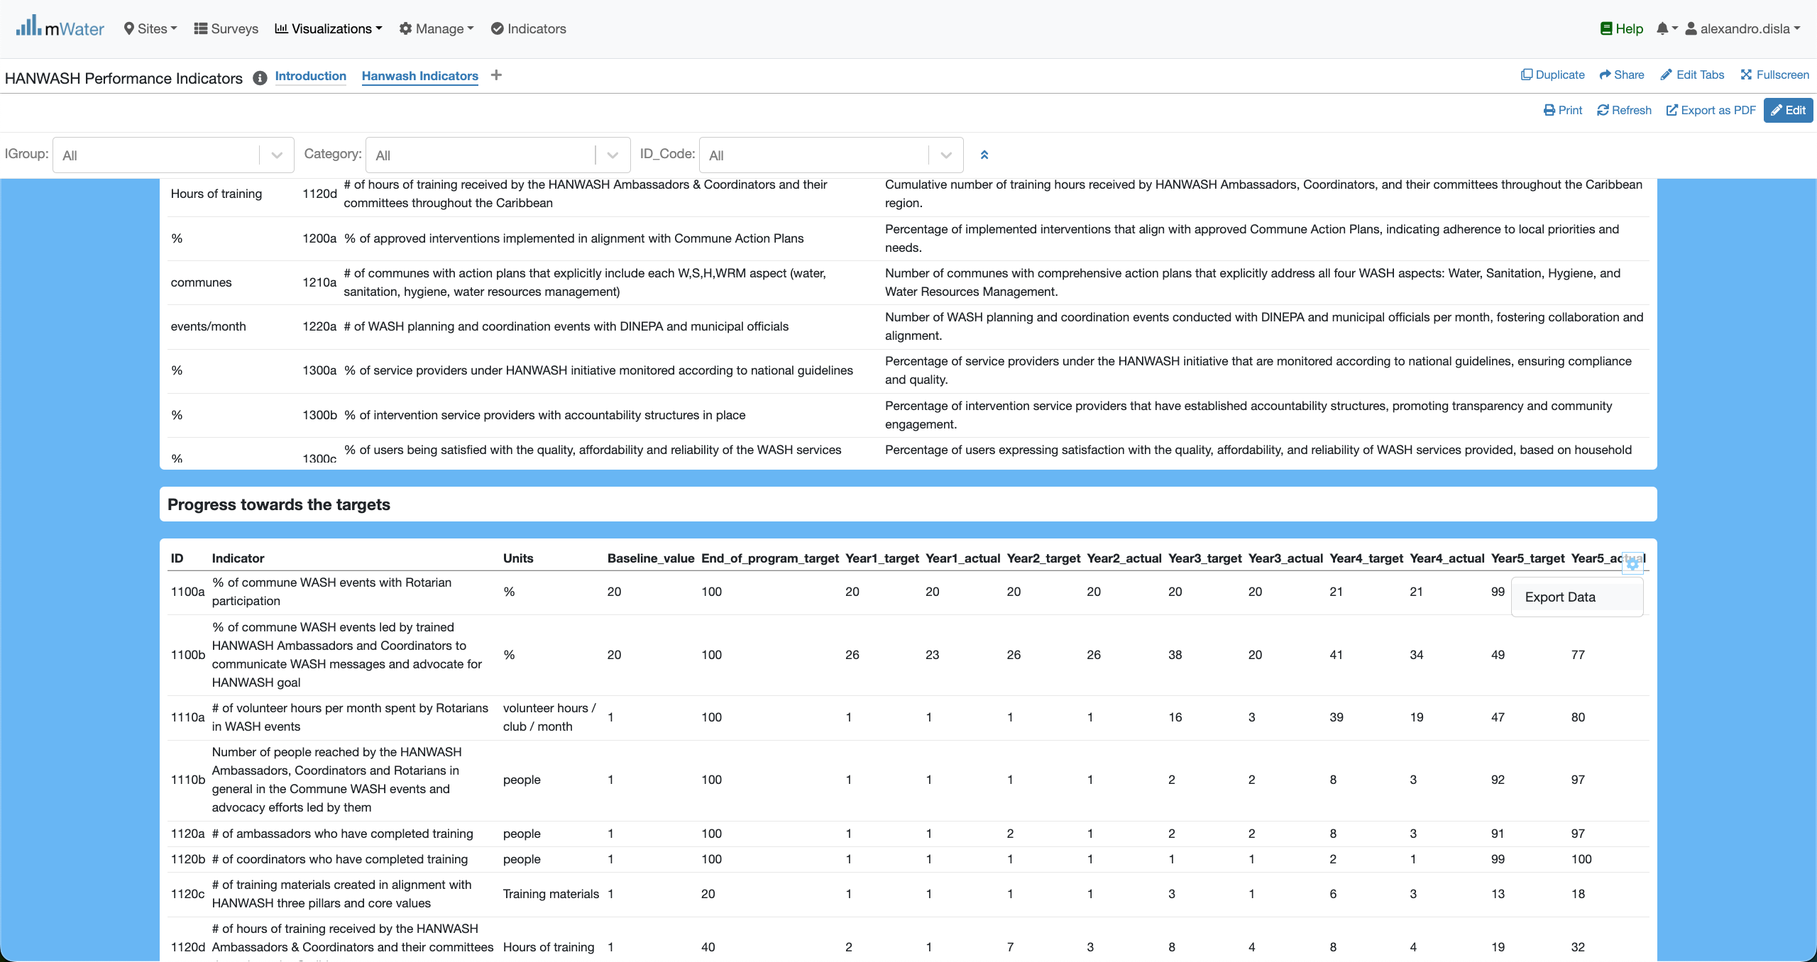
Export Table
This button: Export Data will open a portal.

Slide 26
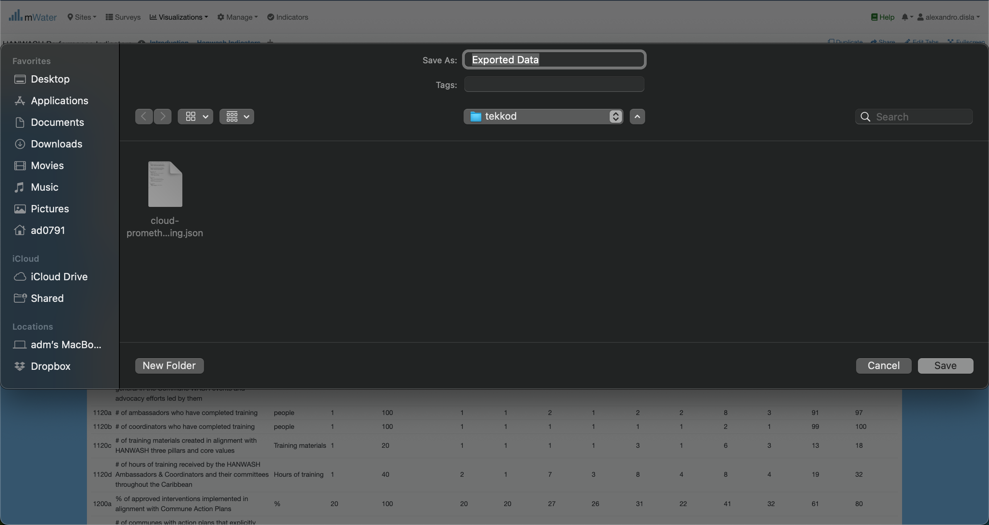
Export Table

Slide 27
Print Export
The print option is available for a global export.

Slide 28
Print Export
The print option is available for a global export.

Slide 29
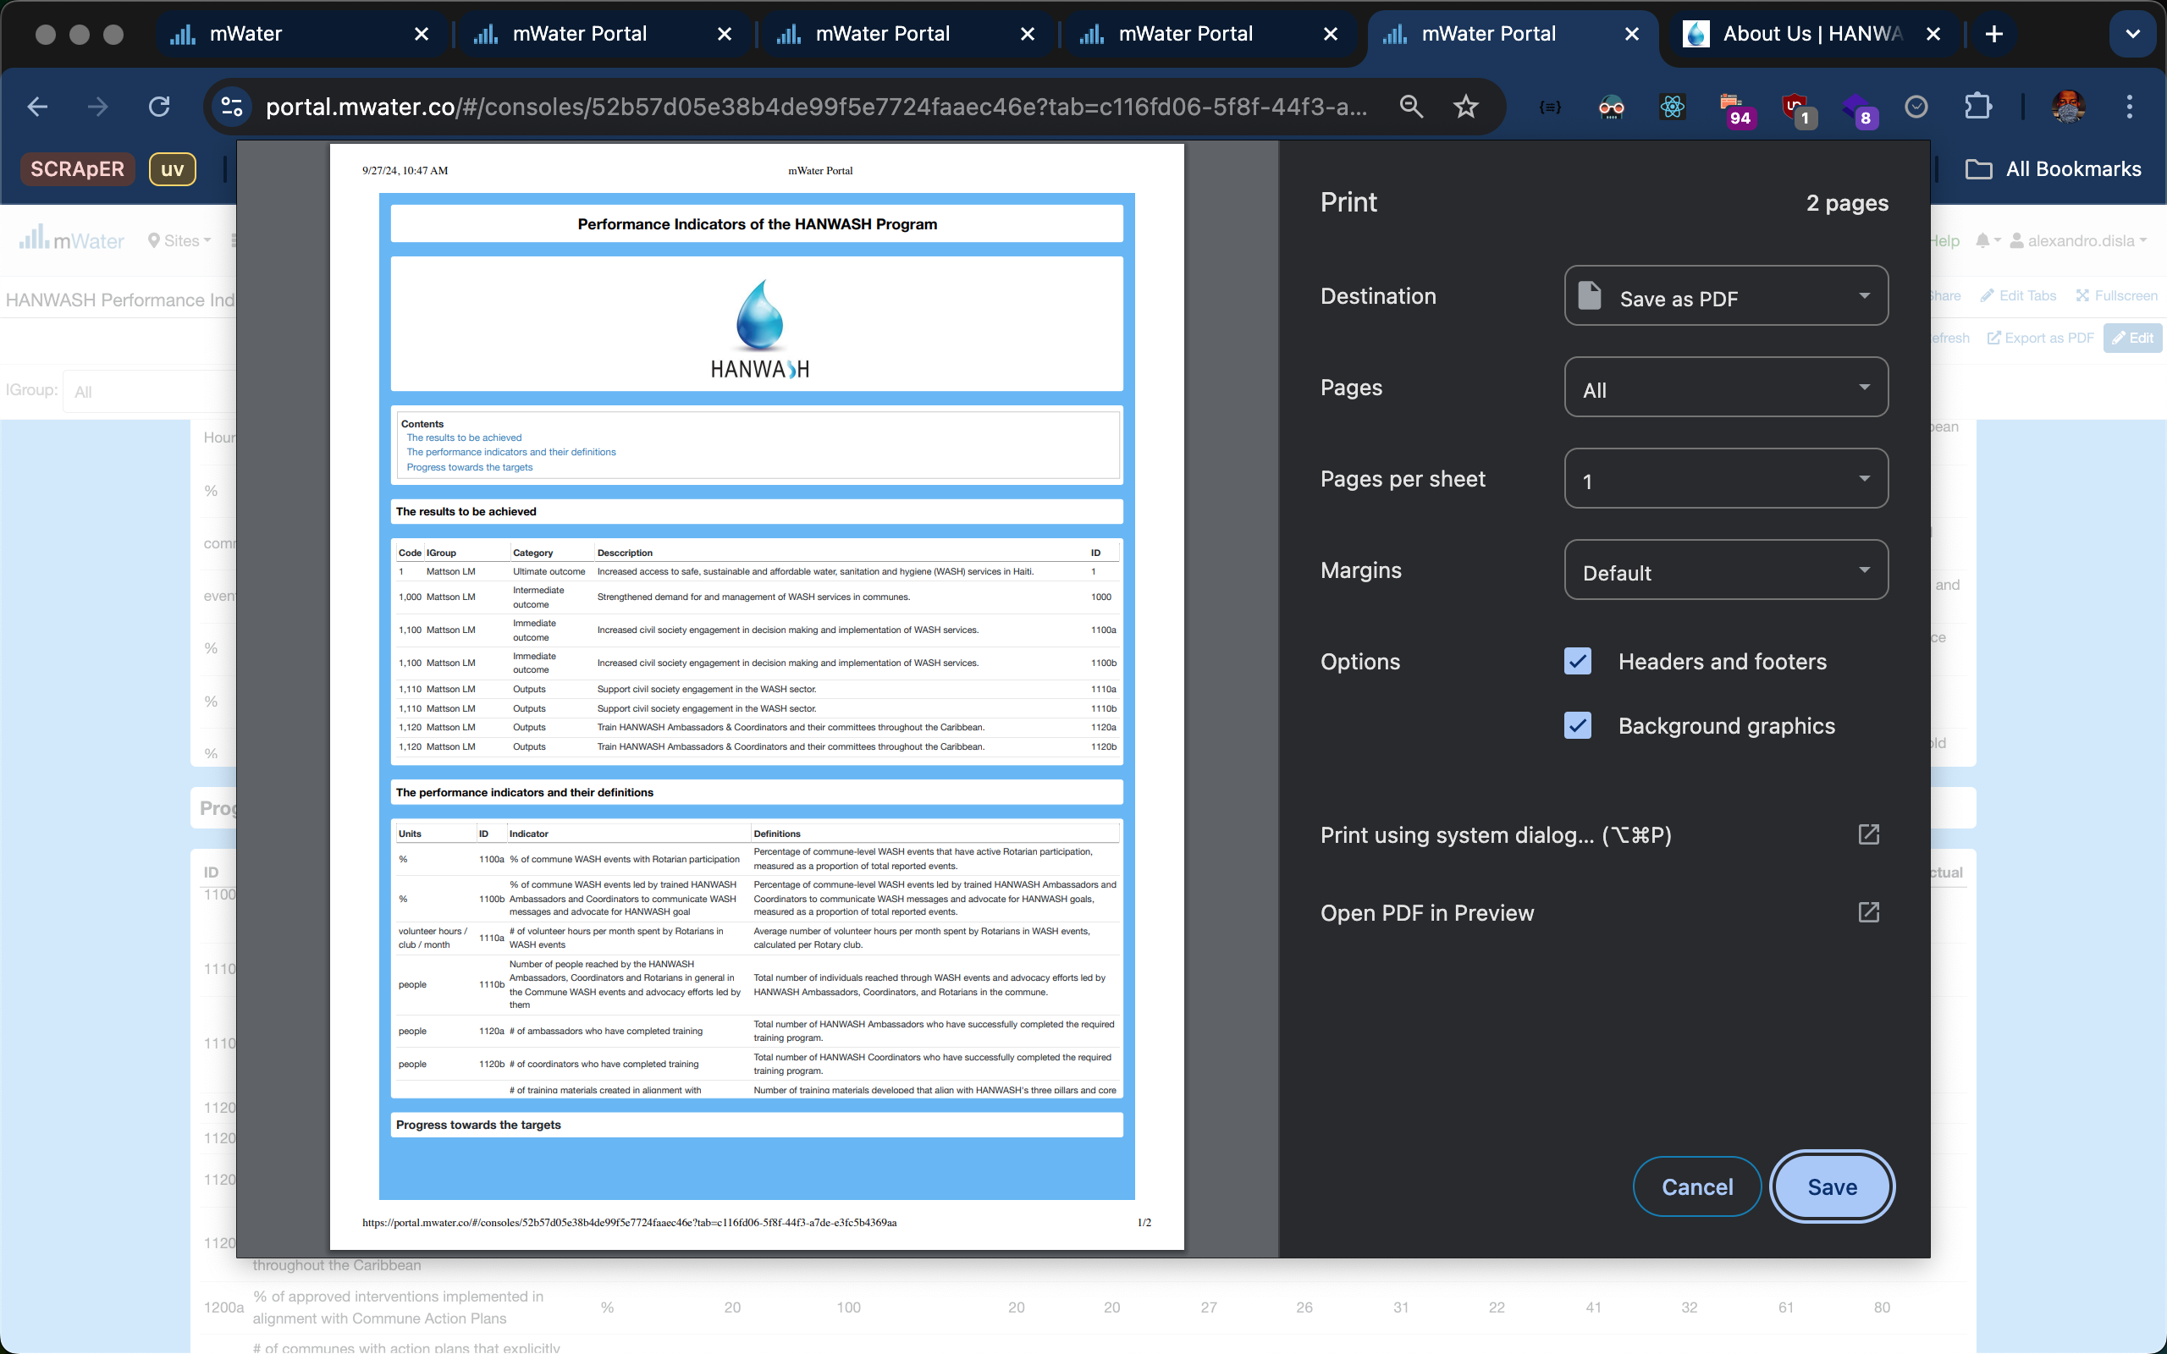
Print EXPORT

Slide 30
Thank You !!!
PLEASE FEEL FREE TO CONTACT ME BY :
Email / alexandro.disla@hanwash.org
Whatsap or Phone / +50941483700

